Slide 1
Data Analytics Workflows in Accounting & Finance
Acctg & Fin | BUS AN 500 | Class 02
Spring Qtr | 2026

Slide 2

What will we do today?
Review
Data Analytics Workflows
Overview & Demo
Warm-up task and RegEx
Mapping a process to a workflow
Demo 2
Propose a workflow
Submission

Slide 3
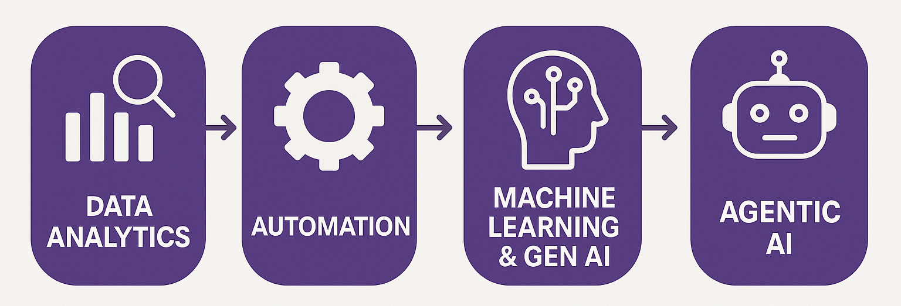
Course Diagram
Transaction analysis
How firms disclose performance

Slide 4
Feedback on Class 01 Submissions
Overall – great job.
Structured task (using the dashboard) – excellent!
Unstructured task (non-GAAP) – great job!
PAR, EBITDA, adjusted Net Income / EPS
Adjustments typically need to be items that are in the GL

Slide 5
What will we do today?
Review
Data Analytics Workflows
Overview & Demo
Warm-up task and RegEx
Mapping a process to a workflow
Demo 2
Propose a workflow
Submission

Slide 6
Course Diagram
Analytics workflows & pipelines

Slide 7
Analytics Workflows & Pipelines
Analytics workflow refers to the logical sequence of analytical steps required to transform inputs into outputs.
Analytics pipeline refers to the operationalized, often automated system that executes those steps, typically with an emphasis on scalability, repeatability, and data movement.
Workflows
Logic Focused
Manual or Semi-Automated
Pipelines
System Focused
Automated

Slide 8
What will we do today?
Review
Data Analytics Workflows
Overview & Demo
Warm-up task and RegEx
Mapping a process to a workflow
Demo 2
Propose a workflow
Submission

Slide 9
Analytics Workflows
As a demo of building a workflow we will examine an international group taxes workflow.
Setting: Large multinational company with foreign reporting entities.
Objective: Create an effective tax rate report and provide clean data for further analysis.
Problem: Company data is coming from multiple systems and not in a common currency (instead in local currencies).

Slide 10
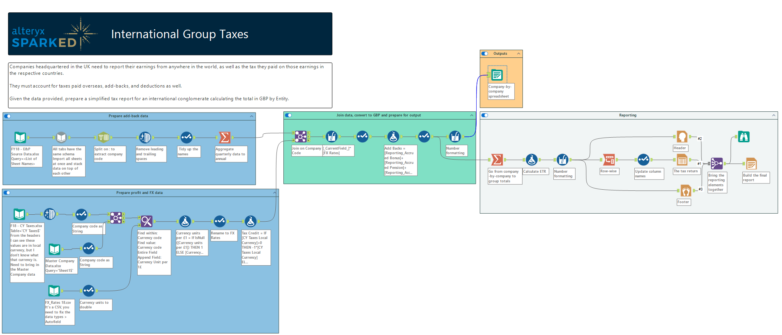

Slide 11
Background on Accounting For Taxes
Accounting measures of tax expense typically do not equal the taxes paid in cash by a firm, the “Book-Tax Differences.”
Companies keep separate sets of financial records for financial reporting and for tax.
How much of their profit (net income) does a company pay in tax?

Slide 12
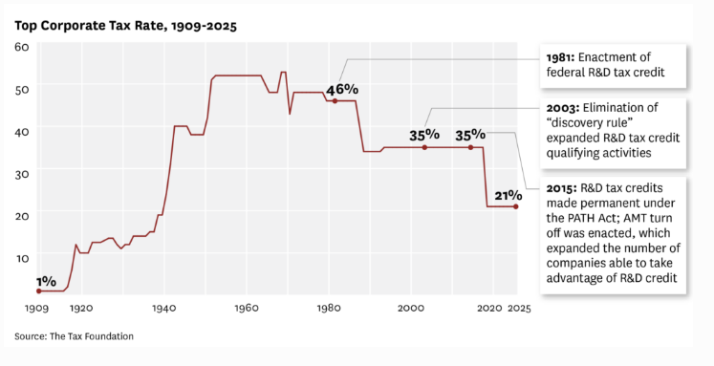

Slide 13
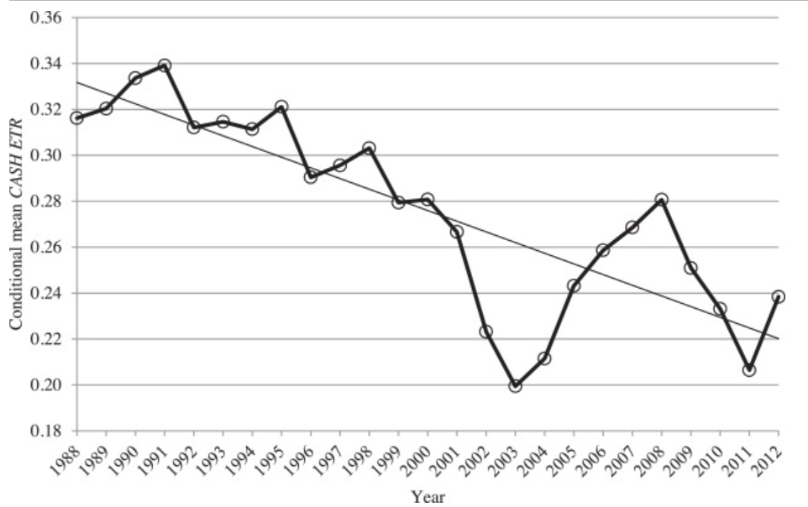
Statutory Tax Rate
Source: Scott D. Dyreng, Michelle Hanlon, Edward L. Maydew, Jacob R. Thornock, Changes in corporate effective tax rates over the past 25 years, Journal of Financial Economics, 2017.

Slide 14
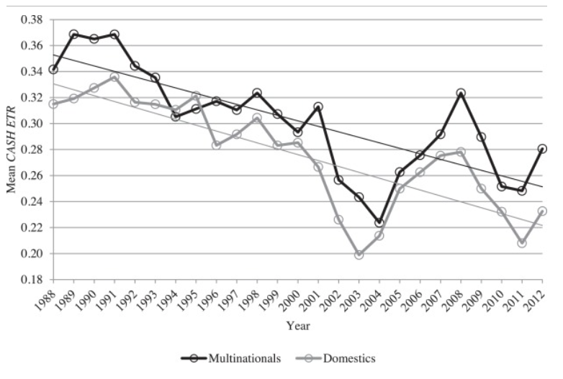
Source: Scott D. Dyreng, Michelle Hanlon, Edward L. Maydew, Jacob R. Thornock, Changes in corporate effective tax rates over the past 25 years, Journal of Financial Economics, 2017.

Slide 15
Book-Tax Differences
Book-Tax Differences = Permanent + Temporary Differences
e.g.,
Fines and Penalties
Non-Taxable Income
e.g.,
Depreciation differences
Deferred compensation

Slide 16
Depreciation
Accounting uses Depreciation to allocate the cost of an asset over its useful life.
E.g., A building might be expected to last 40 years in service, but a computer may only last 5.
A common way to allocate the cost is to divide the cost over the useful life of the asset.

Slide 17
Straight-line depreciation examples
For example:
July 1st 2025: Company purchases a computer for $1800. The useful life is estimated at 5 years / 60 months:
Depreciation = $1800/60 = $30 / month.

Slide 18
Depreciation schedule
Fiscal Year Ending | Depreciation Expense | Running Balance* | Why?
2025 | $180 | $180 | Asset in use for six months
2026 | $360 | $540 | Annual amount
2027 | $360 | $900 | Annual amount
2028 | $360 | $1,260 | Annual amount
2029 | $360 | $1,620 | Annual amount
2030 | $180 | $1,800 | Fully depreciated
* The running balance is a contra-asset called Accumulated Depreciation, a negative number to offset the asset’s original balance, typically reported on a net basis on the balance sheet.

Slide 19
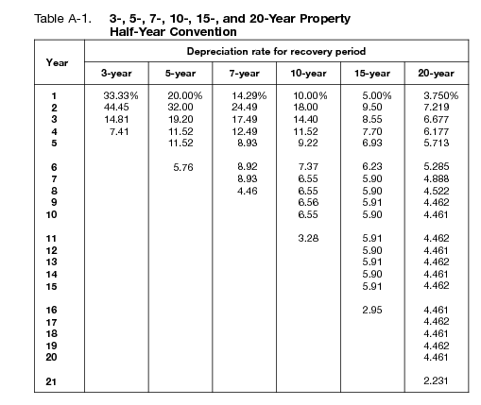
IRS Tax schedules
IRS uses an accelerated method for tax deductions called:
MACRS = Modified Accelerated Cost Recovery System
IRS publication 946: Appendix A.

Slide 20
Tax Depreciation schedule (MACRS)
Fiscal Year Ending | Depreciation Expense | Running Balance | Why?
2025 | $360 | $360 | DDB*, Half-year convention
2026 | $576 | $936 | Accelerated amount
2027 | $345.60 | $1281.60 | Accelerated amount
2028 | $207.36 | $1,488.96 | Accelerated amount
2029 | $207.36 | $1,696.32 | Accelerated amount
2030 | $103.68 | $1,800 | Fully depreciated
** Double the declining balance, 2*(1/lifetime in yrs), for 5 yrs 2*1/5 = 40% * 1800 = 720.

Slide 21
Tax-based useful lives, other examples
Short (around 5 years) | Medium (7-10 years) | Long (15+ years)
Equipment (5 yrs) | Machinery (7 yrs) | Land Improvements (15 years)
Cars (5 years) | Office Furniture (7 yrs) | Commercial Real Estate (39 years)
Computers (5 yrs) | Manufacturing Equipment (up to 10) | Residential Rental Property (27.5 years)

Slide 22
Bonus Depreciation
Bonus Depreciation Tax Regulations in the US grant a temporary tax shield to depreciable assets.
Historical examples:
2001–2004 (post 9/11 stimulus): up to 50% bonus depreciation
2008-2010 (financial crisis stimulus): 50%
2018-2022 (TCJA): 100% bonus deprecation

Slide 23
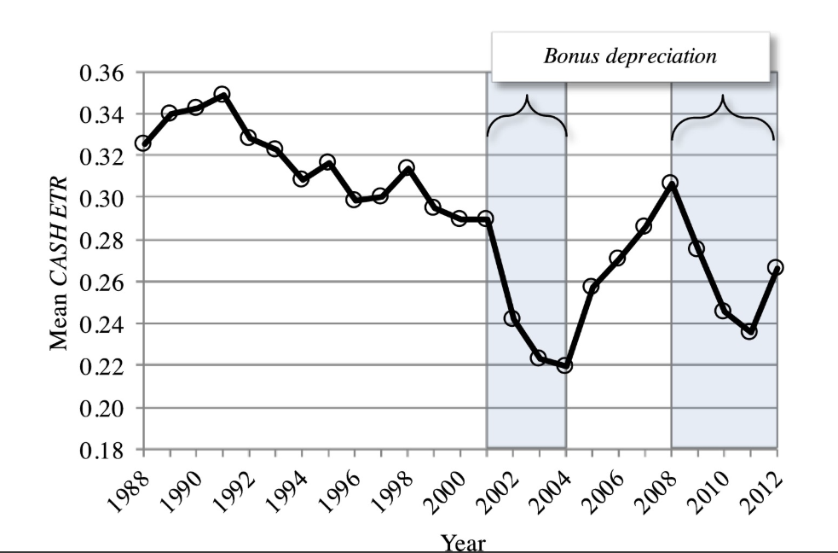
Source: Scott D. Dyreng, Michelle Hanlon, Edward L. Maydew, Jacob R. Thornock, Changes in corporate effective tax rates over the past 25 years, Journal of Financial Economics, 2017.

Slide 24
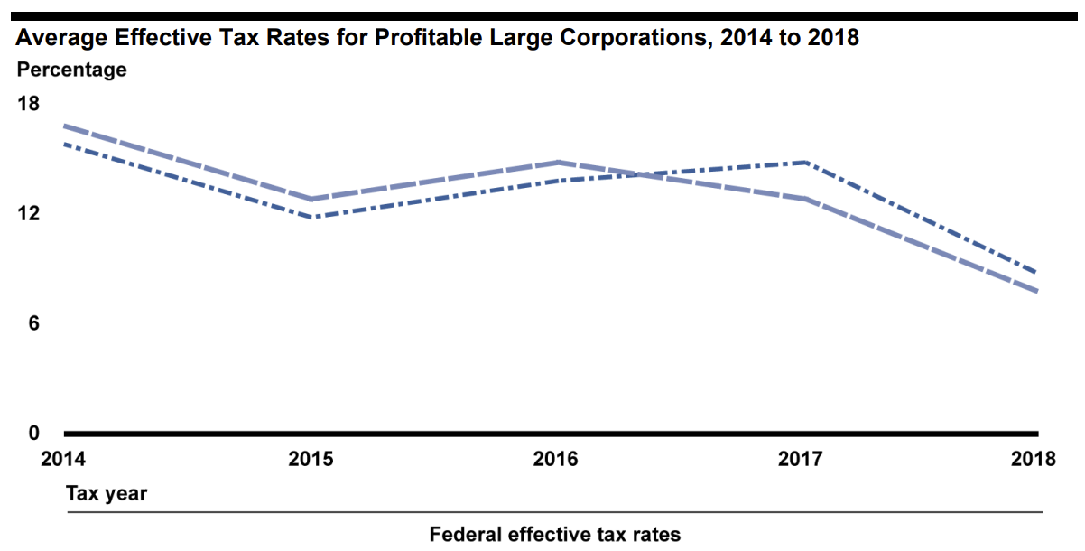
https://www.gao.gov/assets/gao-23-105384.pdf

Slide 25
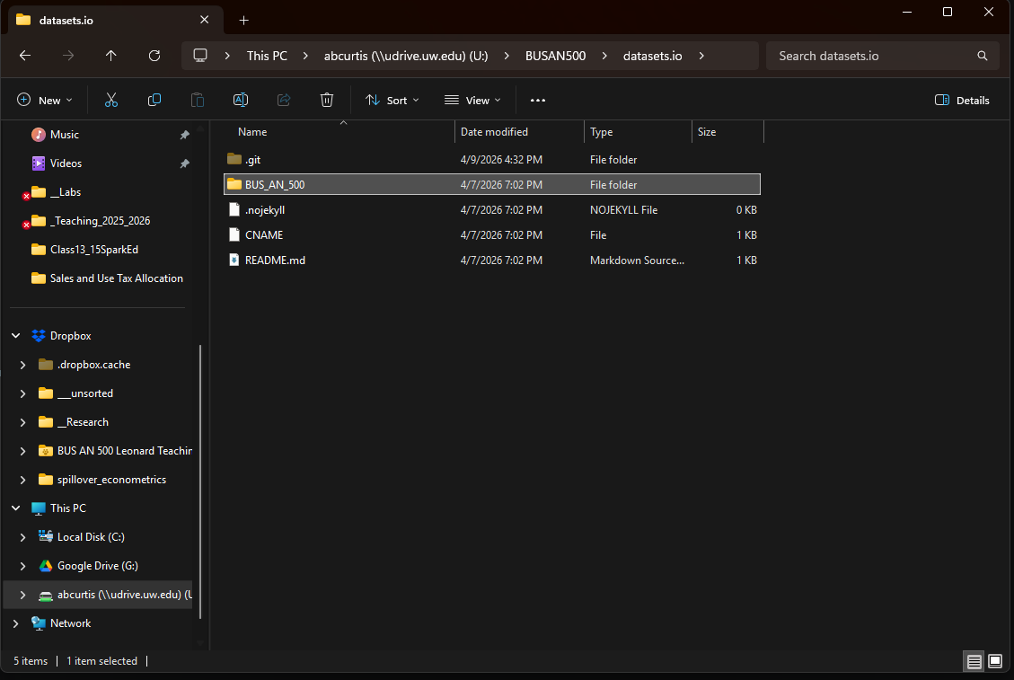
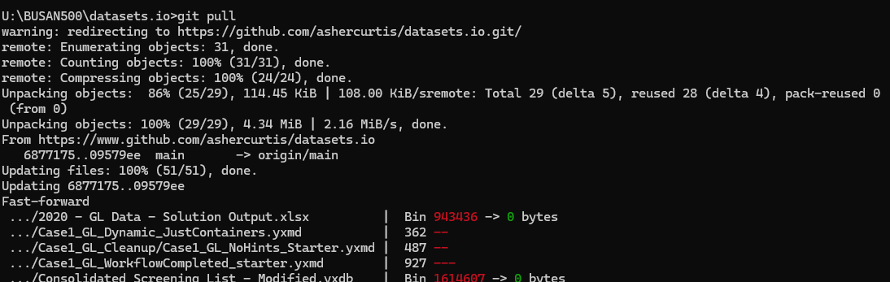
datasets.io folder
cmd then enter
git pull
If no folder, in u: drive add a folder, cmd then enter, and use:
Git clone https://www.github.com/ashercurtis/datasets.io

Slide 26
Start
4
End
2
*Load the Remote Labs
Either git clone or git pull the data

Slide 27
Demo
Bring in the quarterly E&P data, clean it, and aggregate it into yearly totals for each company.
Bring in the other datasets and blend them into one stream so that each company code has the associated filing entity, tax values, and FX rates.
Combine the two streams and apply the FX rate to income, tax and add-backs. Calculate the taxable income and taxes required given a 19% tax rate.
Prepare a spreadsheet with company totals.
Calculate the effective tax rate and prepare a formatted tax return PDF for the entire organization showing pre-tax income, add backs, taxable income, tax, and effective tax rate.
Notes:
Acronyms: E&P is earnings and profit, FX is foreign exchange, in this case add backs are in the CY Taxes Data and include many different categories such as:

Slide 28
Start
4
End
2

Slide 29
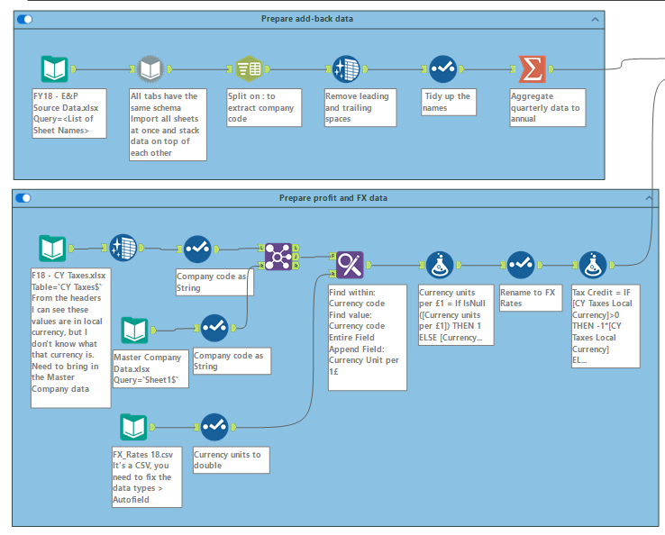
Step 1
import and prepare data
Import
Clean-up
Joins
Calculations

Slide 30
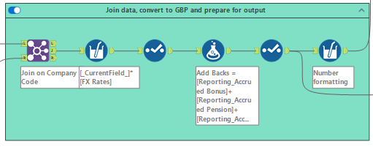
Consolidate to a single data source for the company
Convert all amounts to common currency
Aggregate to desired account level (add backs, taxable income, tax)

Slide 31
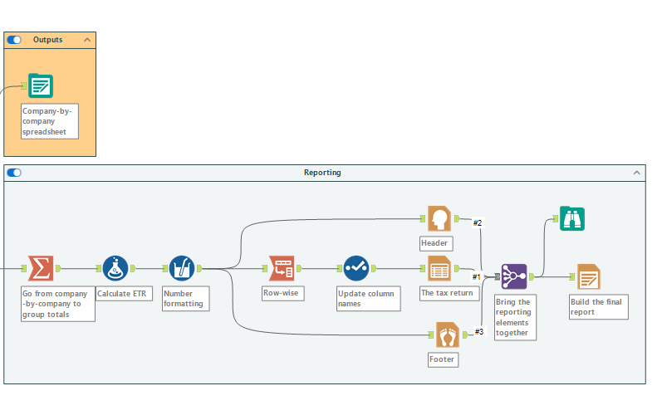
Output desired data and report
Report requires some additional formatting steps and calculations

Slide 32
What will we do today?
Review
Data Analytics Workflows
Overview & Demo
Warm-up task and RegEx
Mapping a process to a workflow
Demo 2
Propose a workflow
Submission

Slide 33
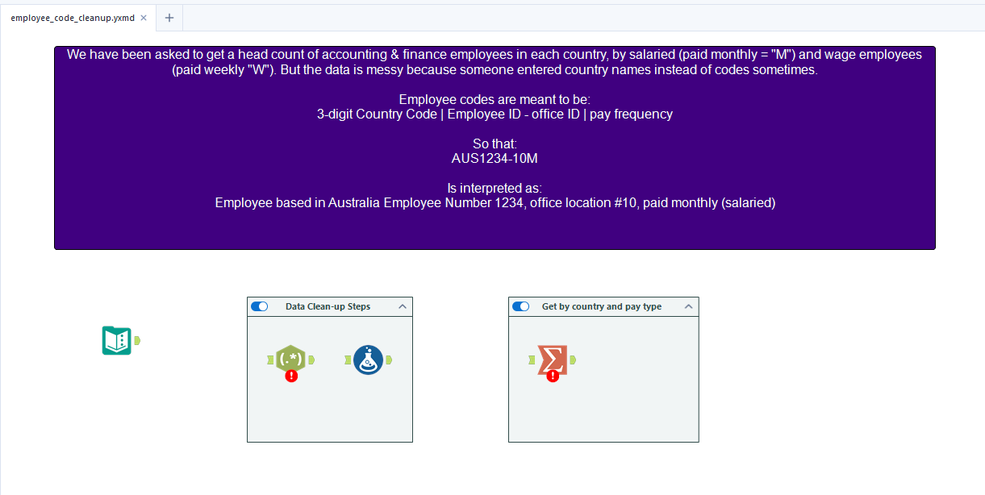

Slide 34
What will we do today?
Review
Data Analytics Workflows
Overview & Demo
Warm-up task and RegEx
Mapping a process to a workflow
Demo 2
Propose a workflow
Submission

Slide 35
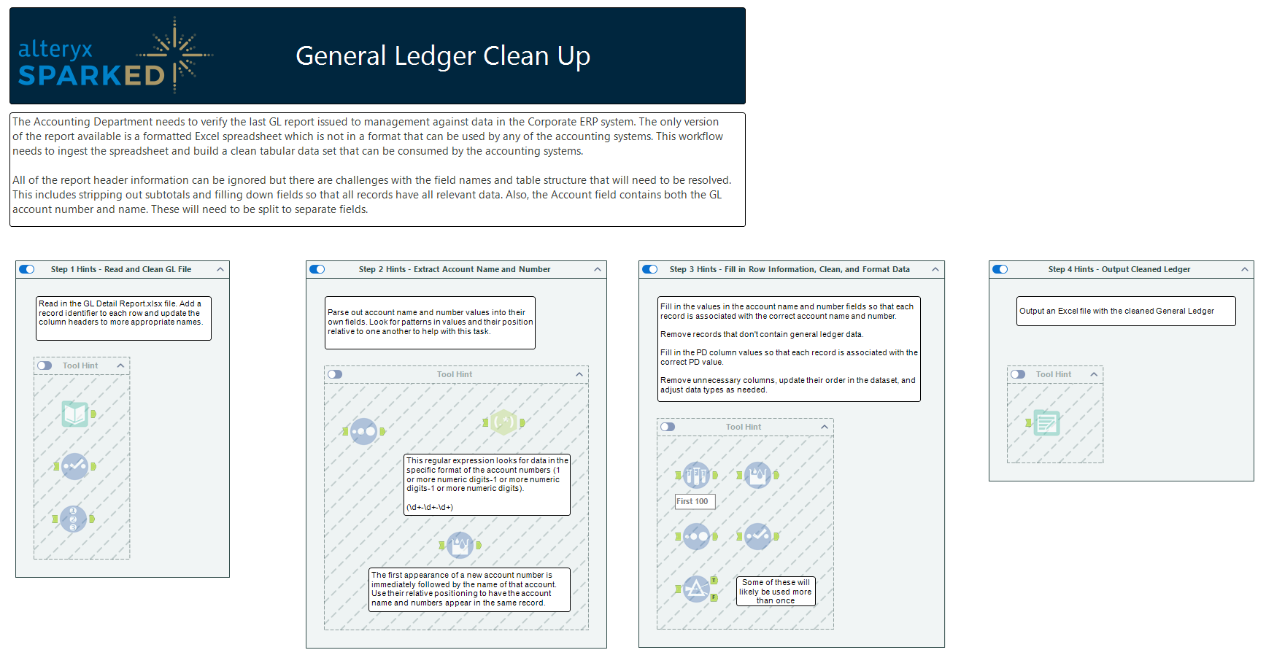

Slide 36
What will we do today?
Review
Data Analytics Workflows
Overview & Demo
Warm-up task and RegEx
Mapping a process to a workflow
Demo 2
Propose a workflow
Submission

Slide 37
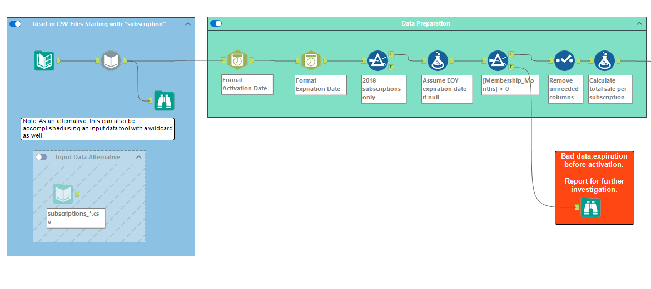
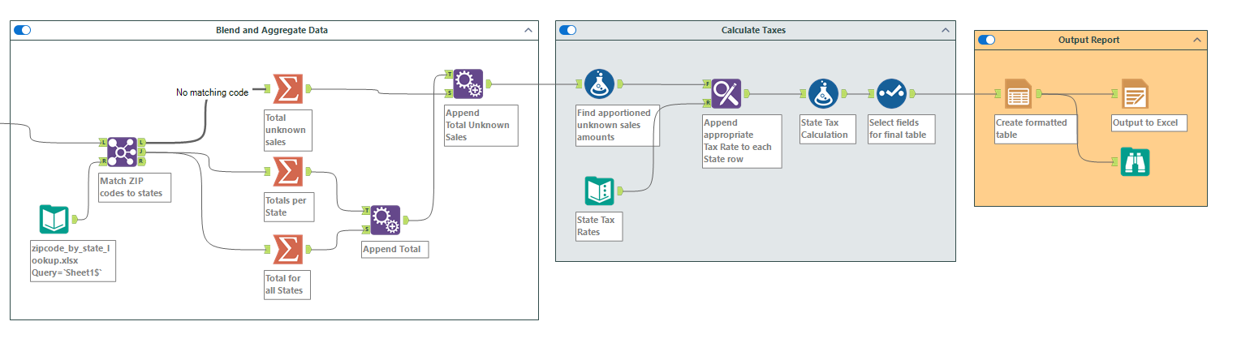

Slide 38
What will we do today?
Review
Data Analytics Workflows
Overview & Demo
Warm-up task and RegEx
Mapping a process to a workflow
Demo 2
Propose a workflow
Submission

Slide 39
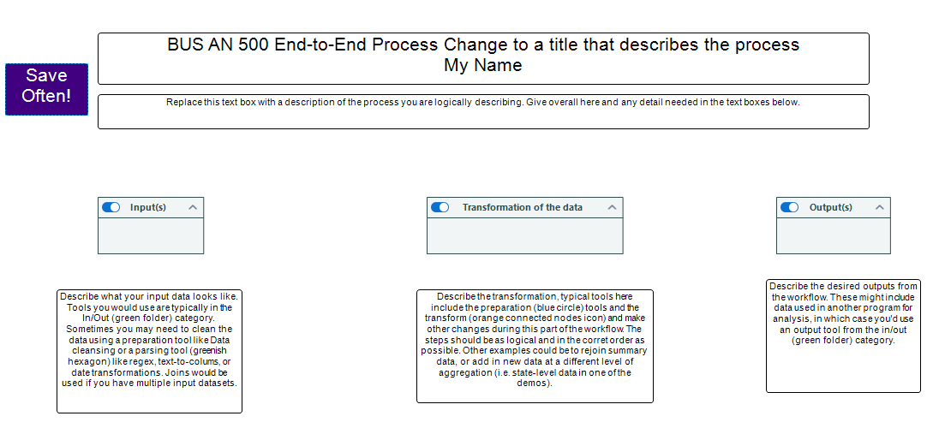

Slide 40
What will we do today?
Review
Data Analytics Workflows
Overview & Demo
Warm-up task and RegEx
Mapping a process to a workflow
Demo 2
Propose a workflow
Submission

Slide 41
Submission
Upload all the files to canvas “Professionalism (individual): Alteryx Submission” submission portal.
All individually or as a single zip (either is fine).

Slide 43
What will we do next?
Automation
Explore the potential for Automation in Accounting & Finance Analytics and more broadly.

Slide 44
Thank you

